Slide 2
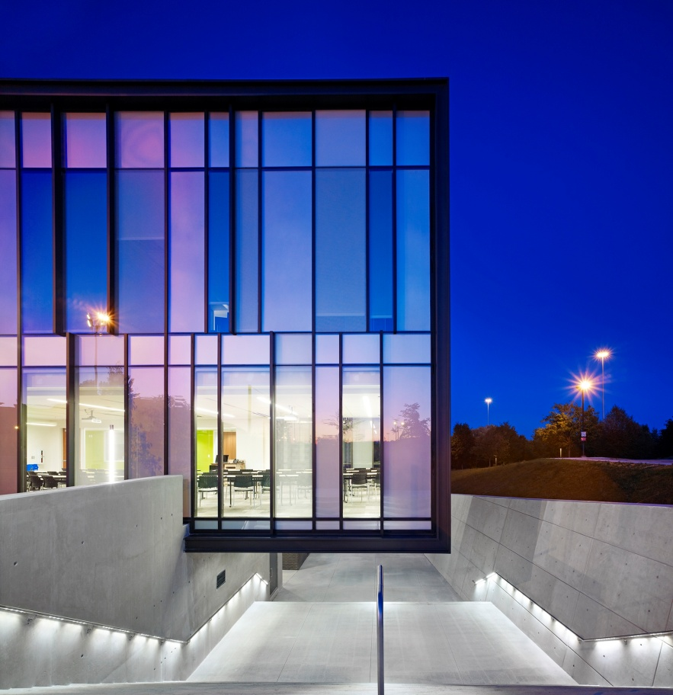
Waterloo Region
One of the most innovative regions in North-America
Cost of living lower than larger cities in Canada (avg. 30% lower)
Home of opportunities:
Google
Toyota
Manulife Financial

Slide 3
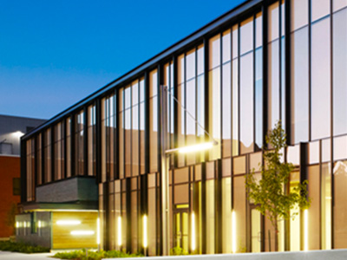
Why Conestoga
Fastest growing College in Ontario in the last 10 years
#1 in Graduate Employment
90.2% of Graduates employment in the last 5 years
+70 nationalities on our campus

Slide 4
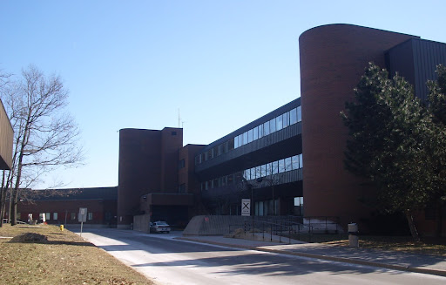
What Else?
Unique programs
Only College to offer Bachelor of Engineering
2 years post-grads.
Pre/post-depature services

